Slide 1
Simplicity and symmetry in physics
Kevin Cahill
Colloquium
27 October 2023

Slide 2
Abstract
Theoretical physics is largely
the mathematical development
of simple ideas guided by experiments.
The uncertainty principle, local symmetry,
the standard model, path integrals and
general relativity are examples.

Slide 3
Outline
The uncertainty principle
The uncertainty principle and spin
The uncertainty principle and the hydrogen atom
Simplicity and symmetry
Gauge invariance
Nonabelian gauge invariance
Path integrals
General coordinate invariance

Slide 4
Simple ideas lie
beneath important
concepts of physics.

Slide 5
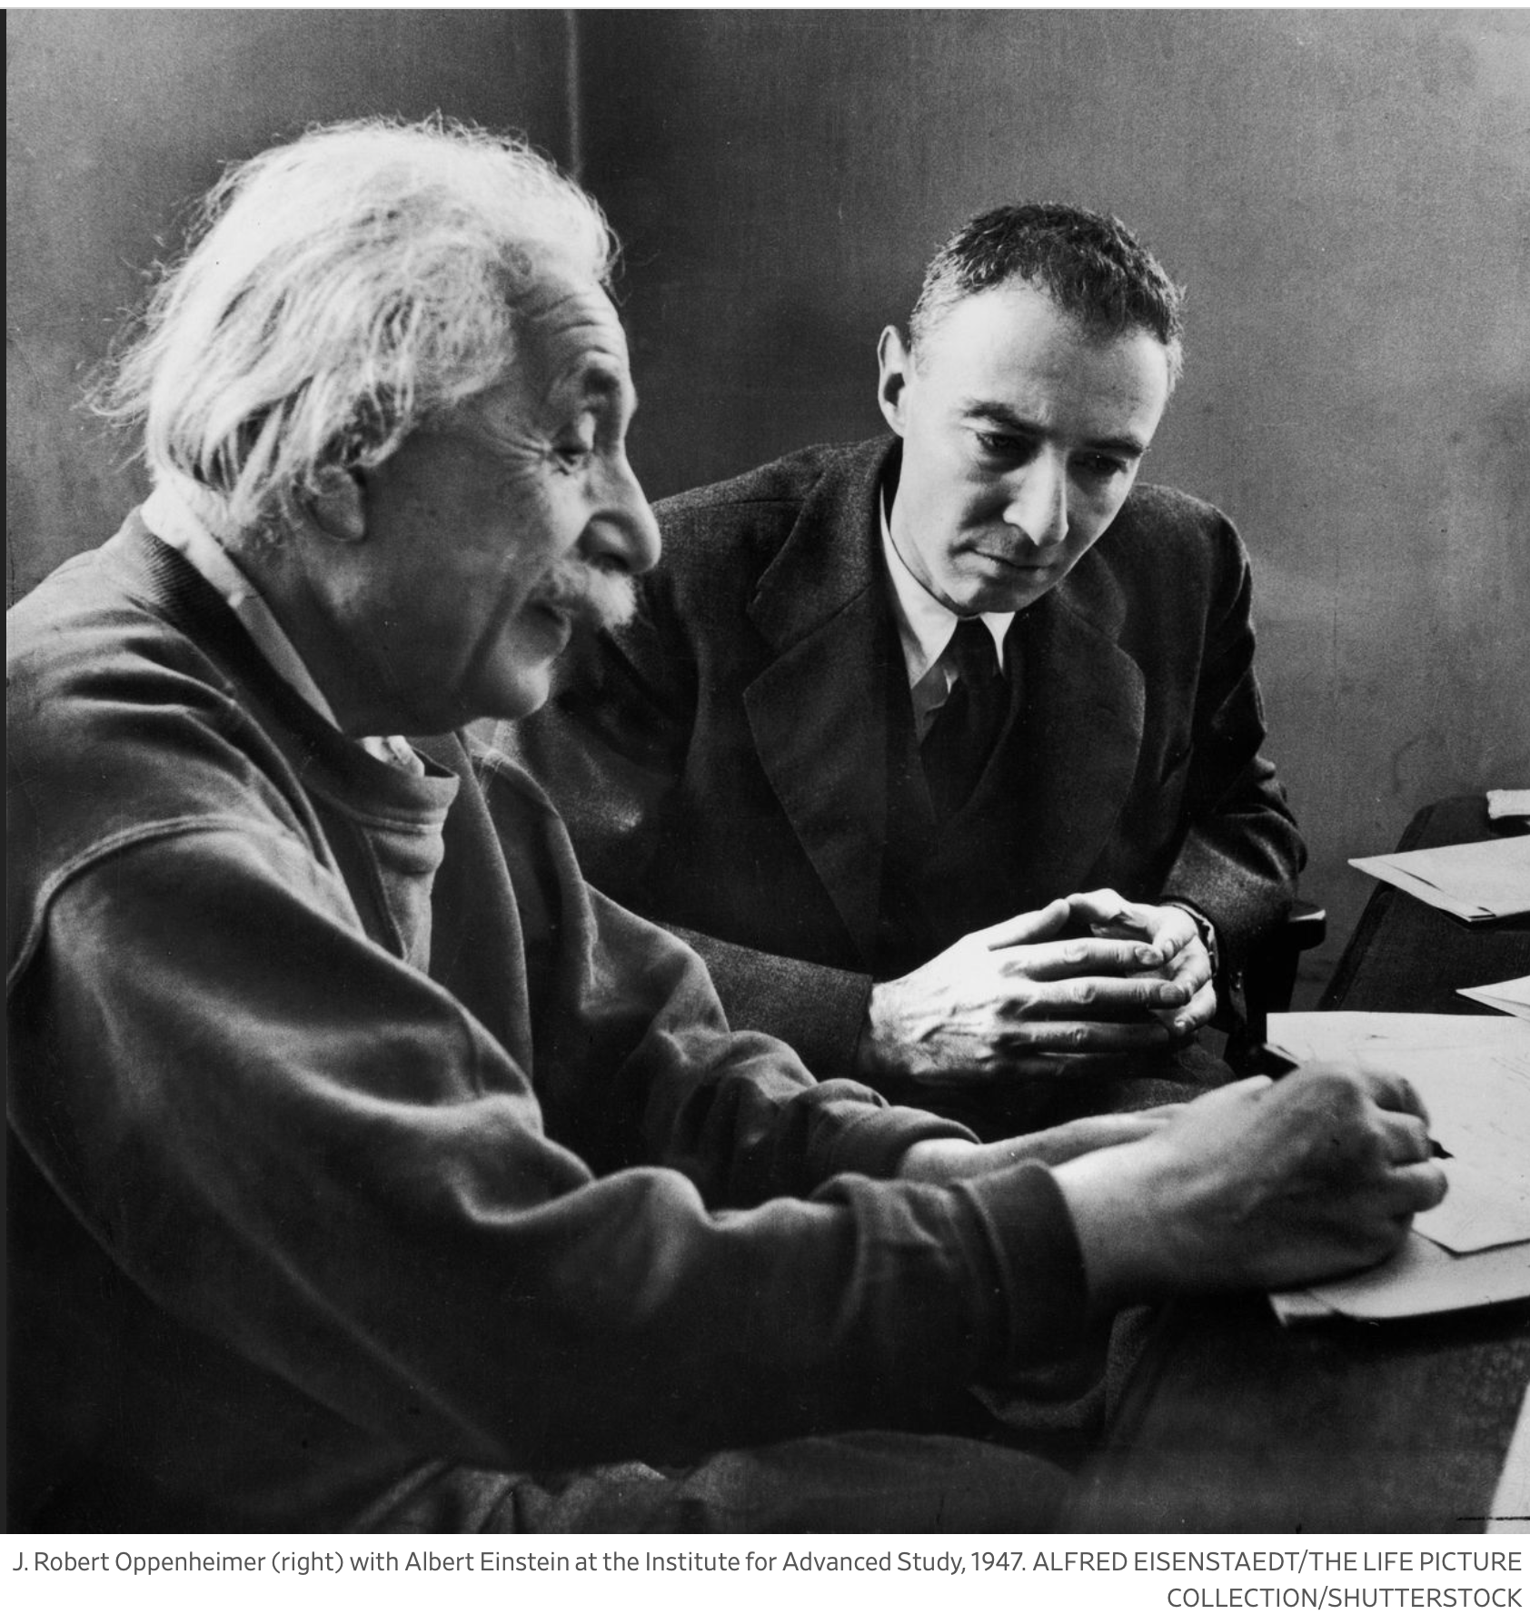
Oppenheimer explains the uncertainty principle:
To use an instrument to measure the position of something, your instrument must be attached to a known position.
To use the recoil of an instrument to measure the momentum of something, your instrument must be free to recoil.

Slide 6
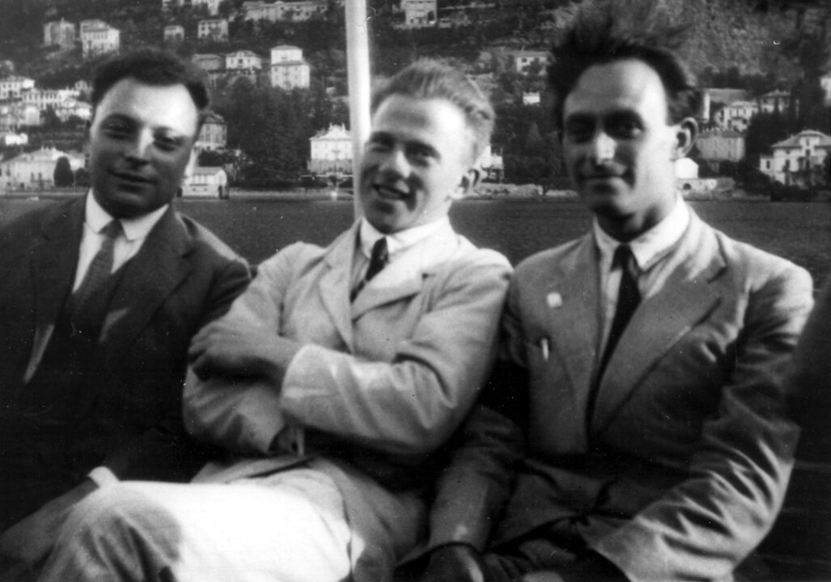
Since an instrument can't simultaneously be both attached and free, one can’t simultaneously measure position and momentum to arbitrary accuracy.
The limit is
Erwin Planck tried in 1944 to assassinate Hitler.
Pauli, Heisenberg and Fermi on Lake Como

Slide 7
Hydrogen atom
, then
, and the energy is
Wild guess: If
with a minimum at
So

Slide 9
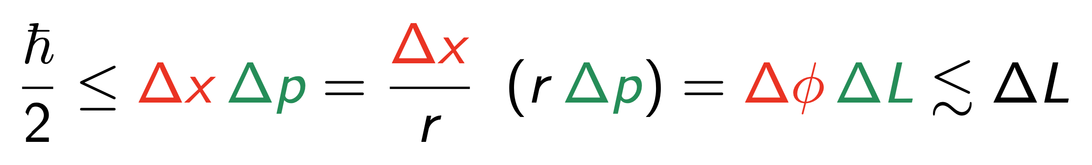
Spin
The known elementary particles have spin
But why are they spinning?

Slide 12
Simplicity = Symmetry

Slide 13
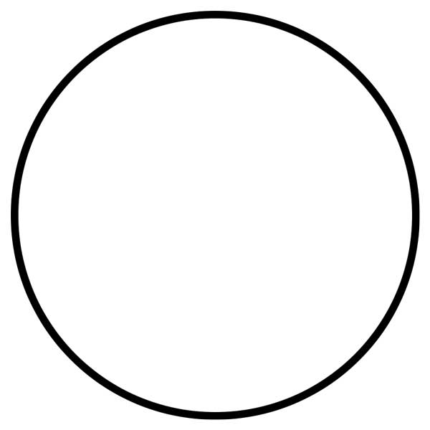
Simplicity and symmetry
The complexity of a thing is the length of its shortest description.
The complexity of a circle
is at most the length
of its equation
.
The complexity of an arbitrary curve
is at least twice the number
of its pixels.
Symmetry makes the circle is simpler — O(2) or U(1).

Slide 14
The complexity of a sphere is less than the length of its equation
Its symmetry is SO(3) or SU(2).
A rambutan
has less symmetry
and more complexity.

Slide 15
The smallest things
are the simplest and
the most symmetrical.

Slide 16
Elementary particles must be simple.
Elementary particles are the smallest objects we know of.
They are the simplest objects we know about because they have no room for complexity.
They must be symmetrical.

Slide 19
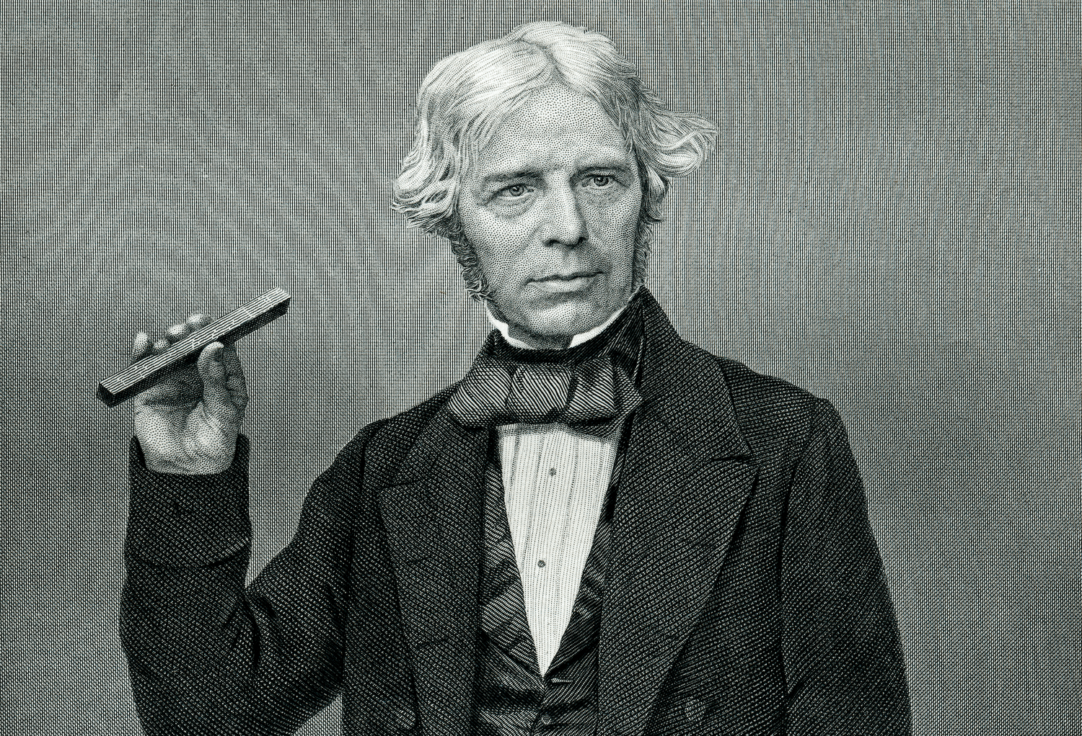
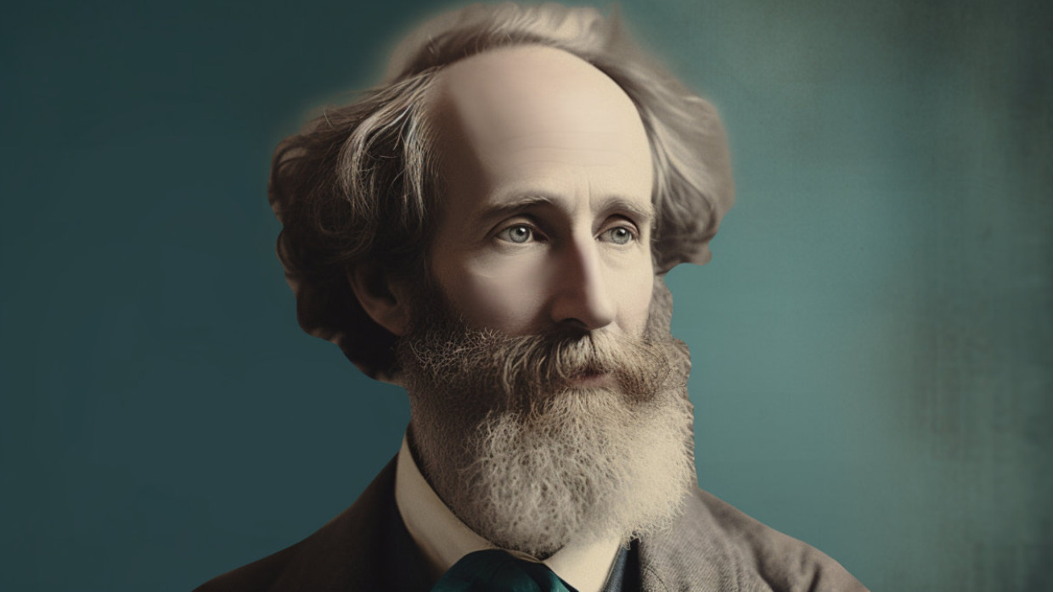
Michael Faraday
James
Clerk
Maxwell

Slide 20
Gauge invariance
The electric and magnetic fields
are the 4-curl of the vector potential
They remain the same when

Slide 22
This local symmetry of classical electrodynamics
foreshadowed the local symmetries of quantum field theories which also require interactions.

Slide 24
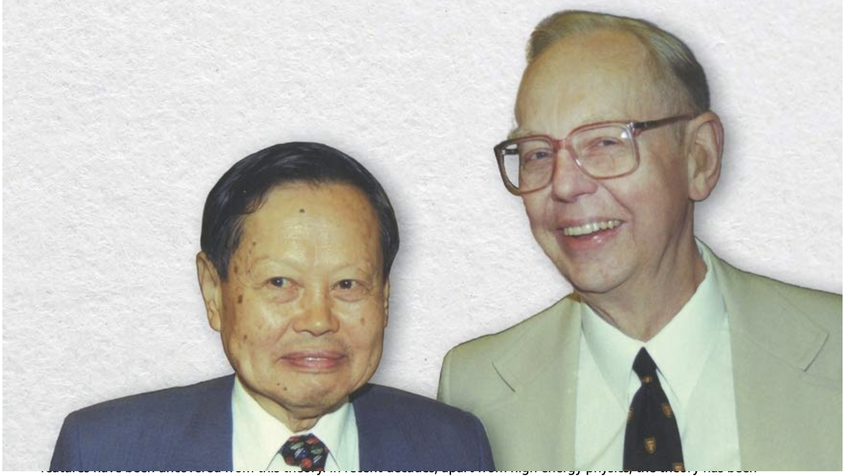
Yang Chen-Ning and Robert L. Mills
Yang and Mills generalized gauge invariance
from U(1) to SU(2).

Slide 25
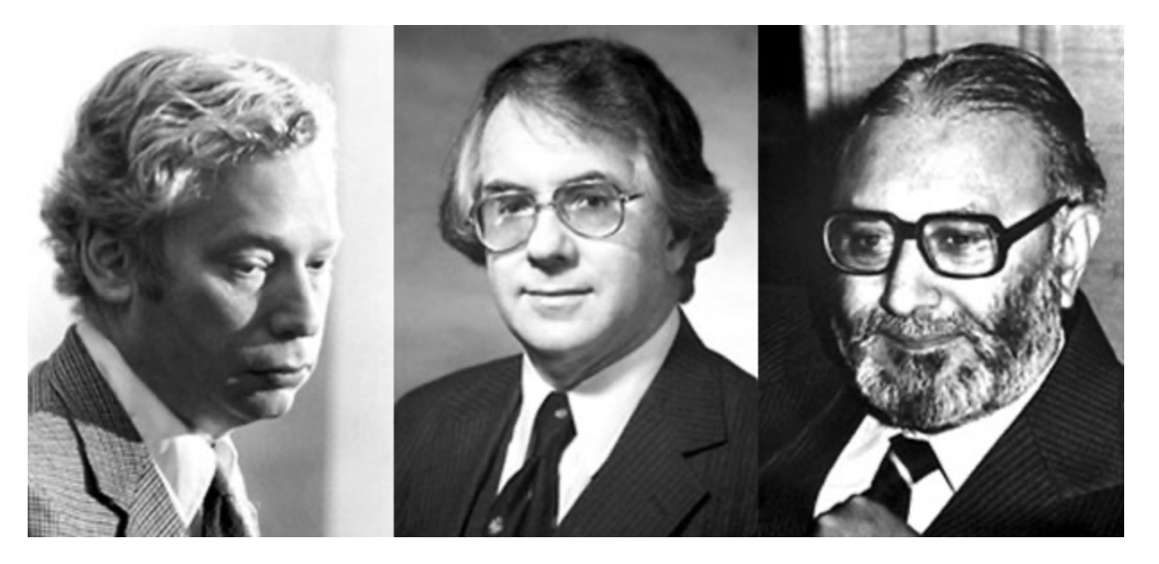

Slide 26
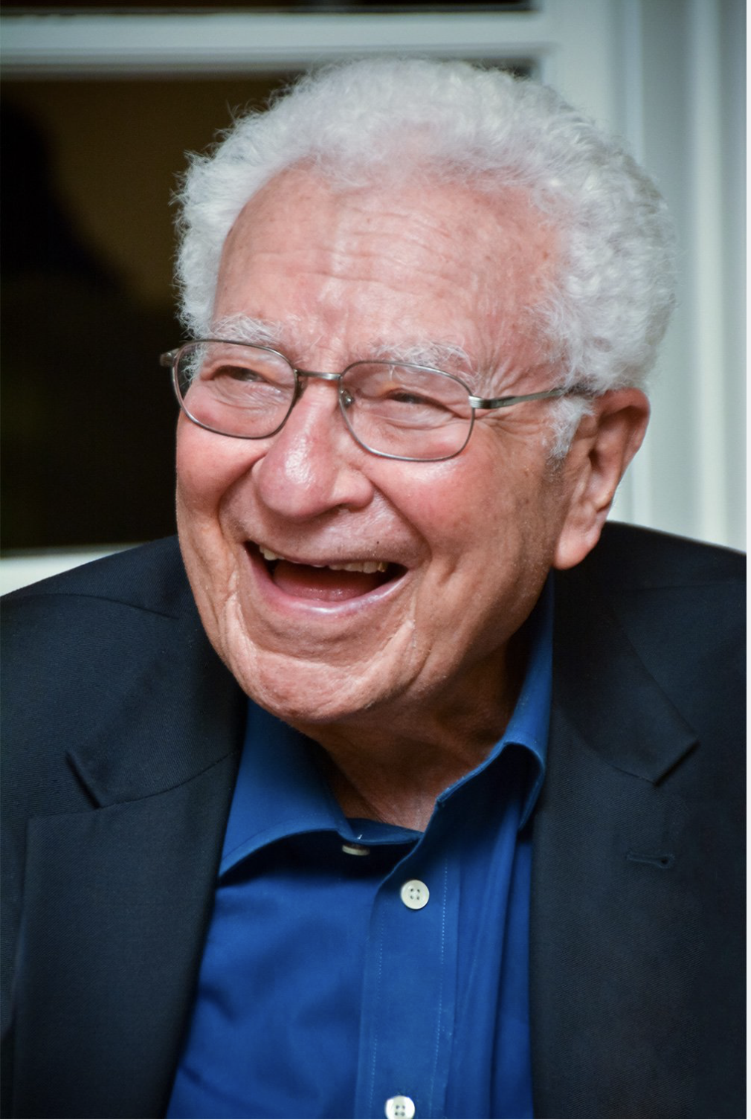
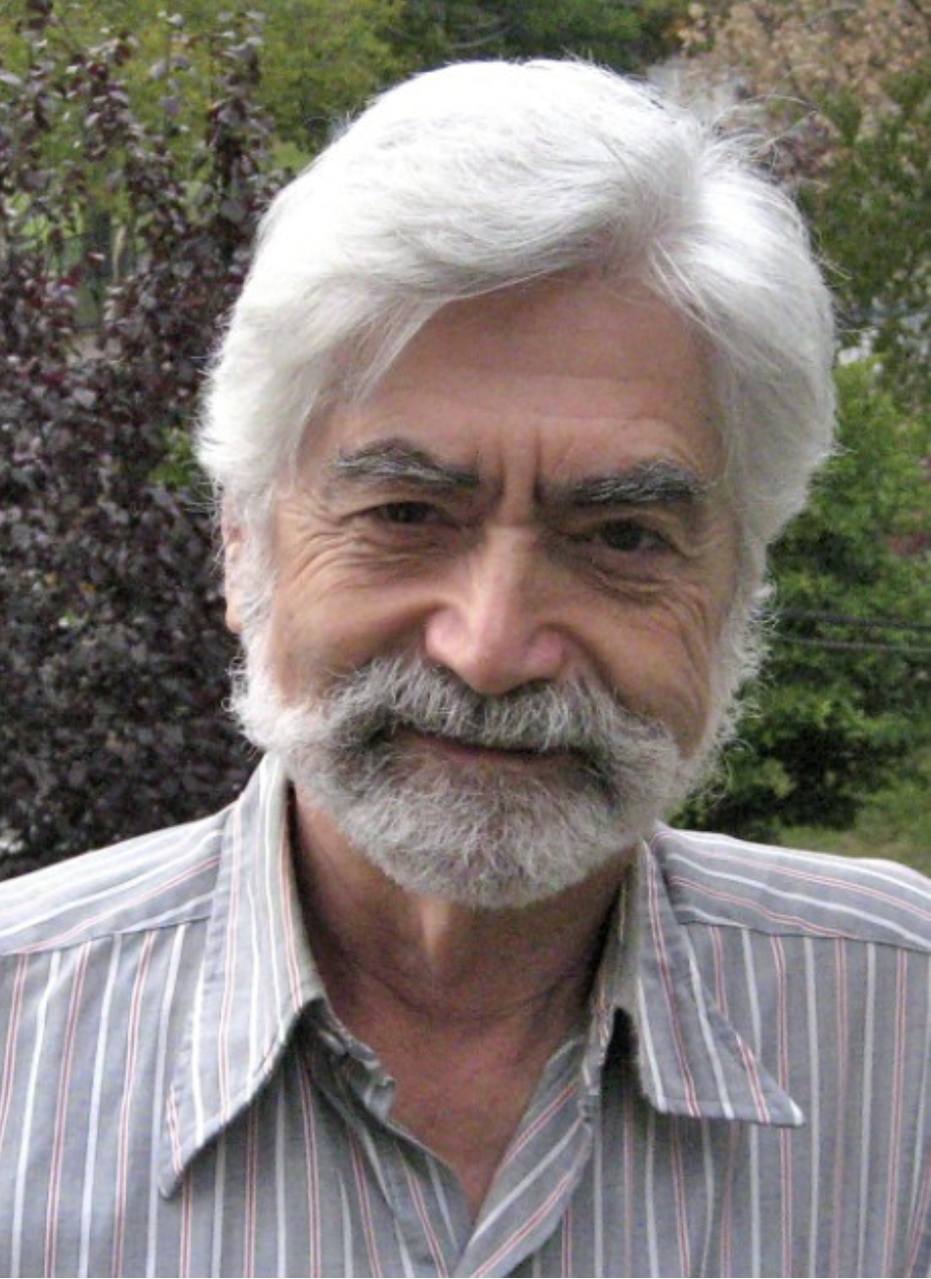

Slide 28
All the interactions of
the standard muddle
are those required by local gauge invariance.
But what about the Higgs?

Slide 29
Proton

Slide 30
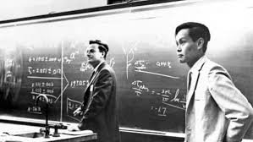
Richard P. Feynman and Yang Chen-Ning

Slide 31
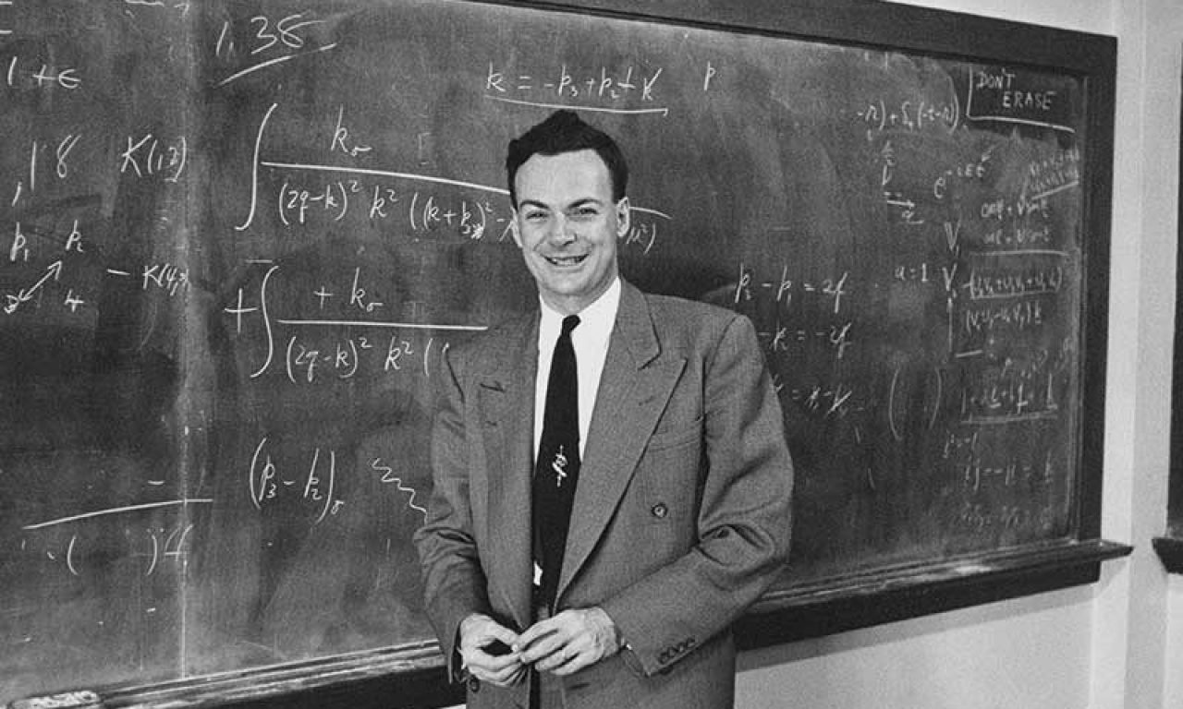
Richard Feynman

Slide 34
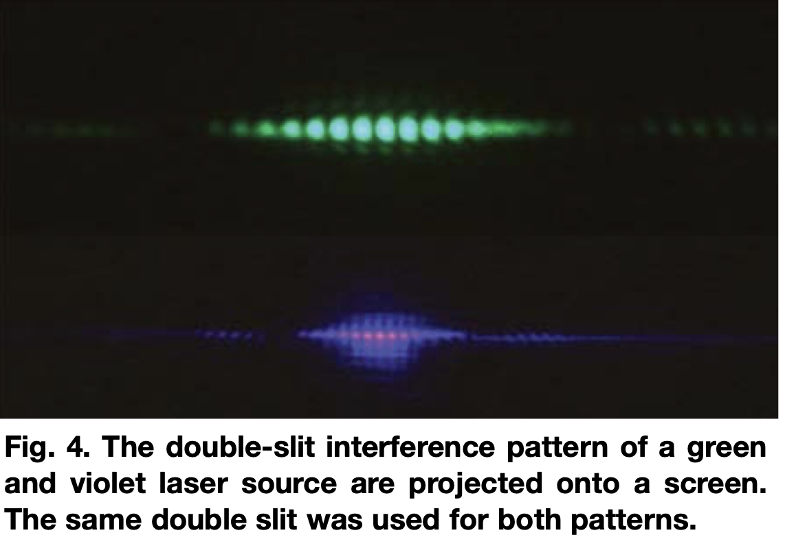
So the demos of optical interference in elementary physics are really demos of Feynman’s path integral.

Slide 36
There are infinitely many processes or ways to go from any start to any finish.

Slide 37
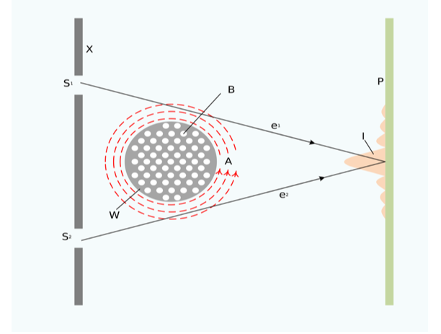

Slide 38
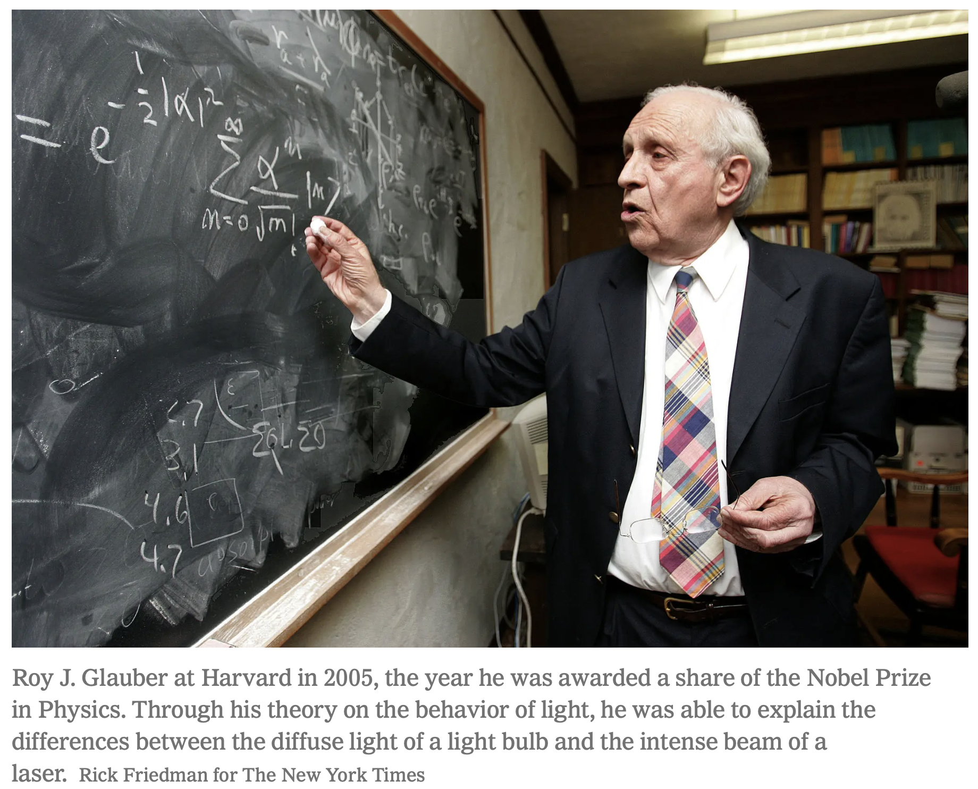

Slide 42
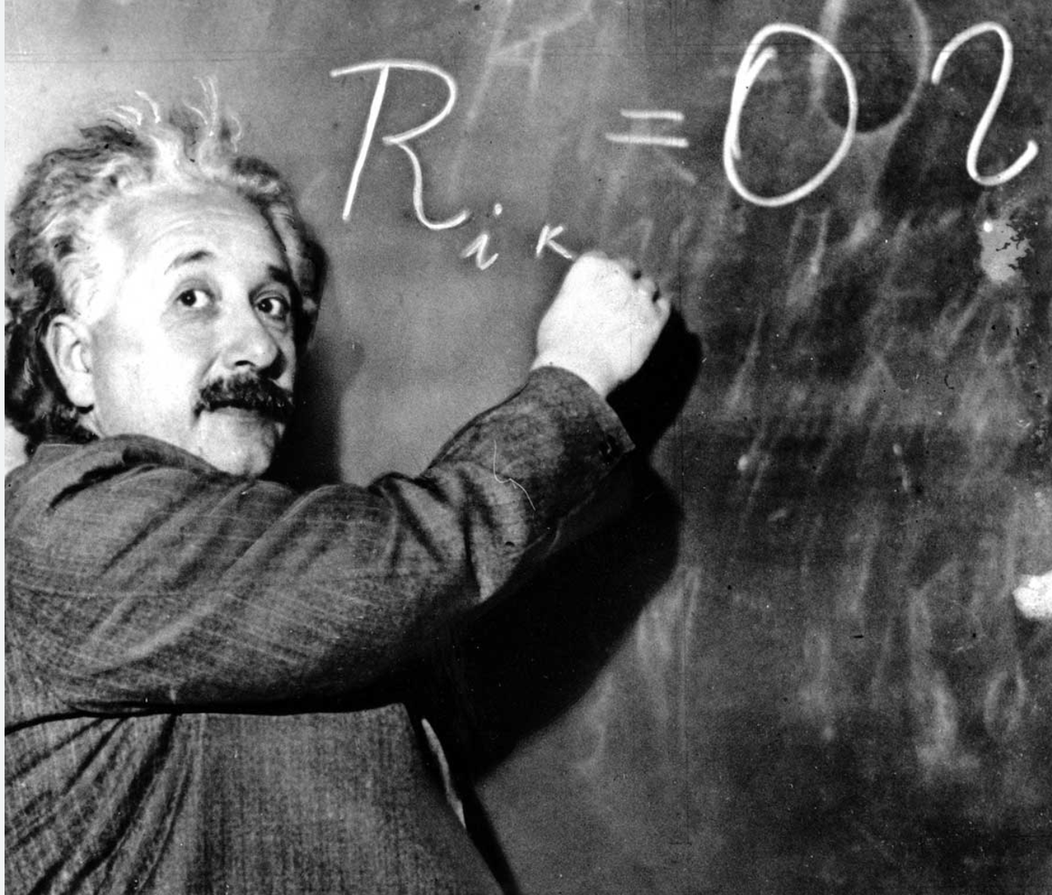
I never think of the future. It comes soon enough.
Once we accept our limits, we go beyond them.
Any fool can know. The point is to understand.
Imagination is more important than knowledge.
Two things are infinite. The universe and
human stupidity — I’m not so sure about the universe.
I never teach my pupils; I only provide the conditions in which they can learn.
Everybody is a genius. But if you judge a fish by its ability to climb a tree,
it will live its whole life believing that it is stupid.
I know not with what weapons World War III will be fought,
but World War IV will be fought with sticks and stones.
The most beautiful thing we can experience is the Mysterious.

Slide 43
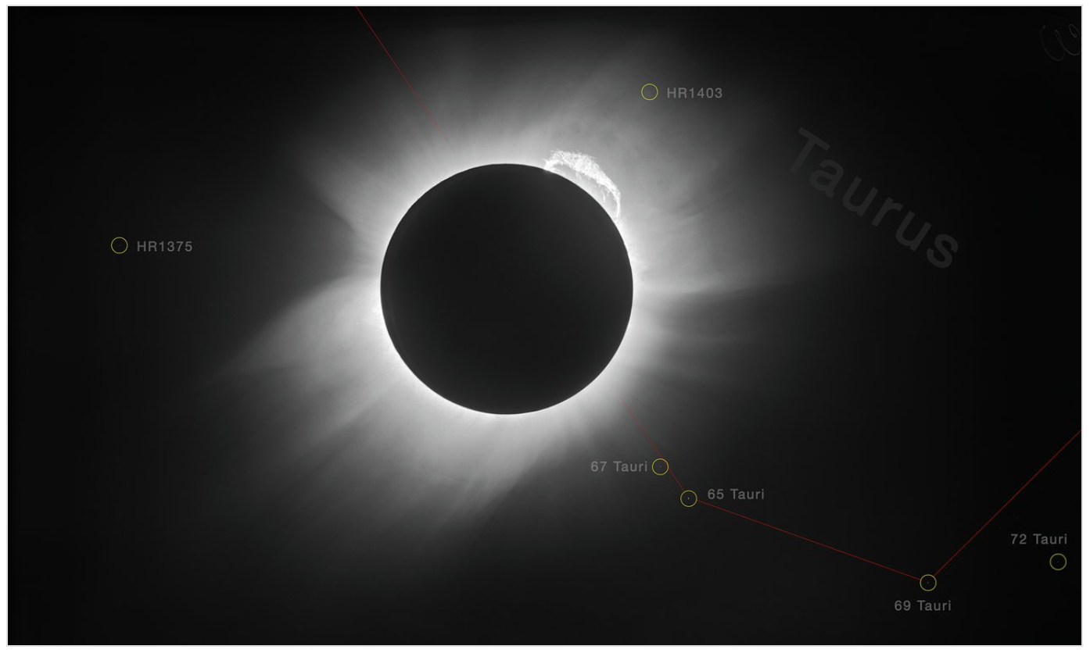
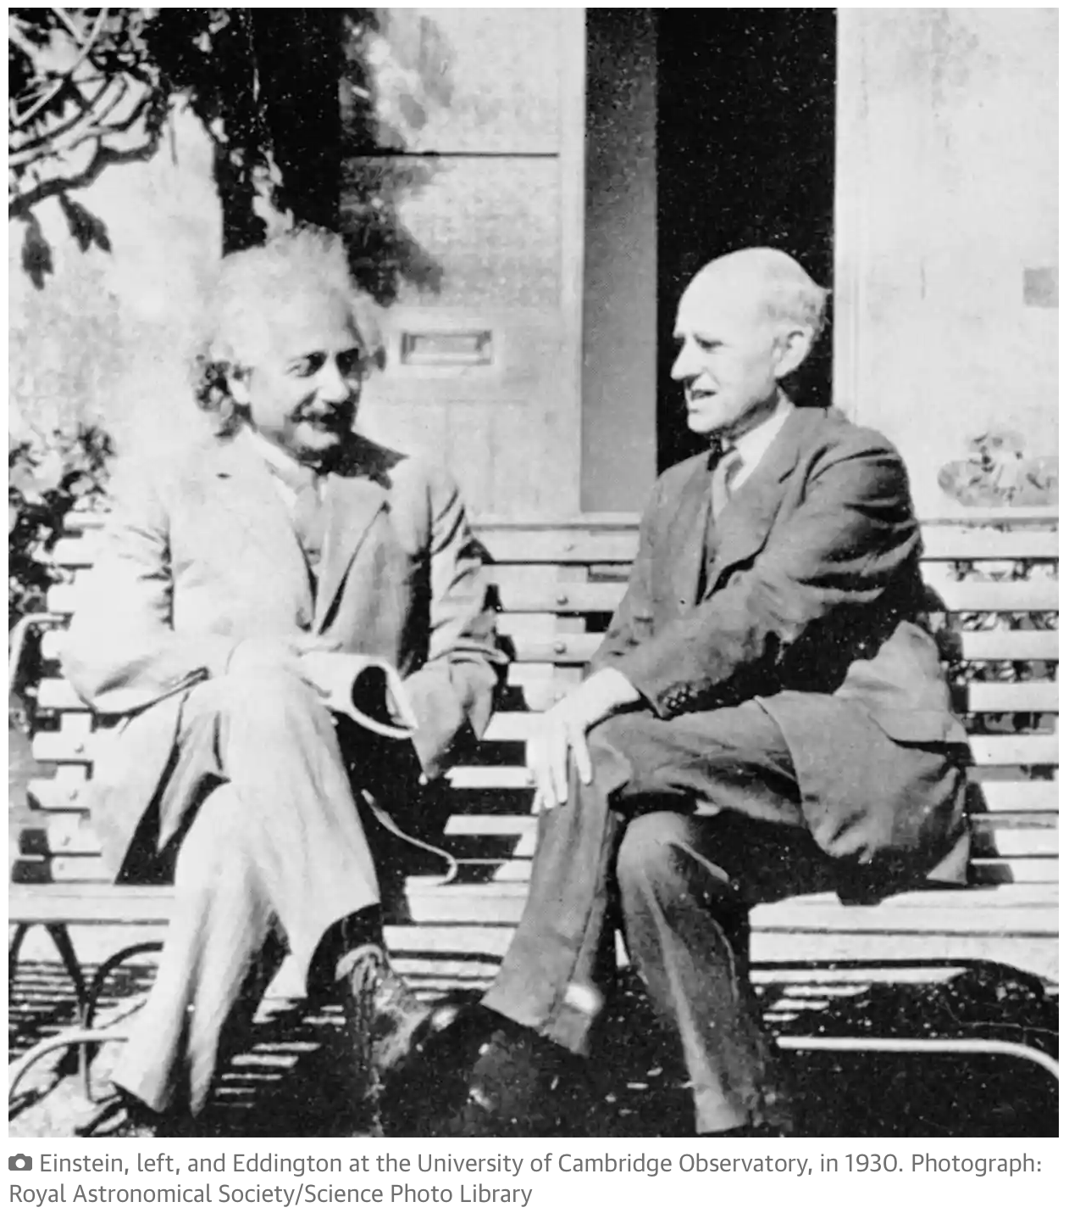
We have no way of knowing which system of coordinates
is the true or best system of coordinates. So we should
write the equations of physics in such a way that
they are the same in all coordinate systems. Who’s the other one?
Eclipse of 1919

Slide 44
“You see,” said Einstein, “this is designed as a model to illustrate the equivalence principle. . . . ” A big grin spread across his face and his eyes twinkled with delight as he said, “And now the equivalence principle.” Grasping the gadget, he thrust it upwards until it touched the ceiling. “Now I will let it drop,” he said, “and according to the equivalence principle there will be no gravitational force. So the spring will now be strong enough to bring the little ball into the plastic tube.”

Slide 45
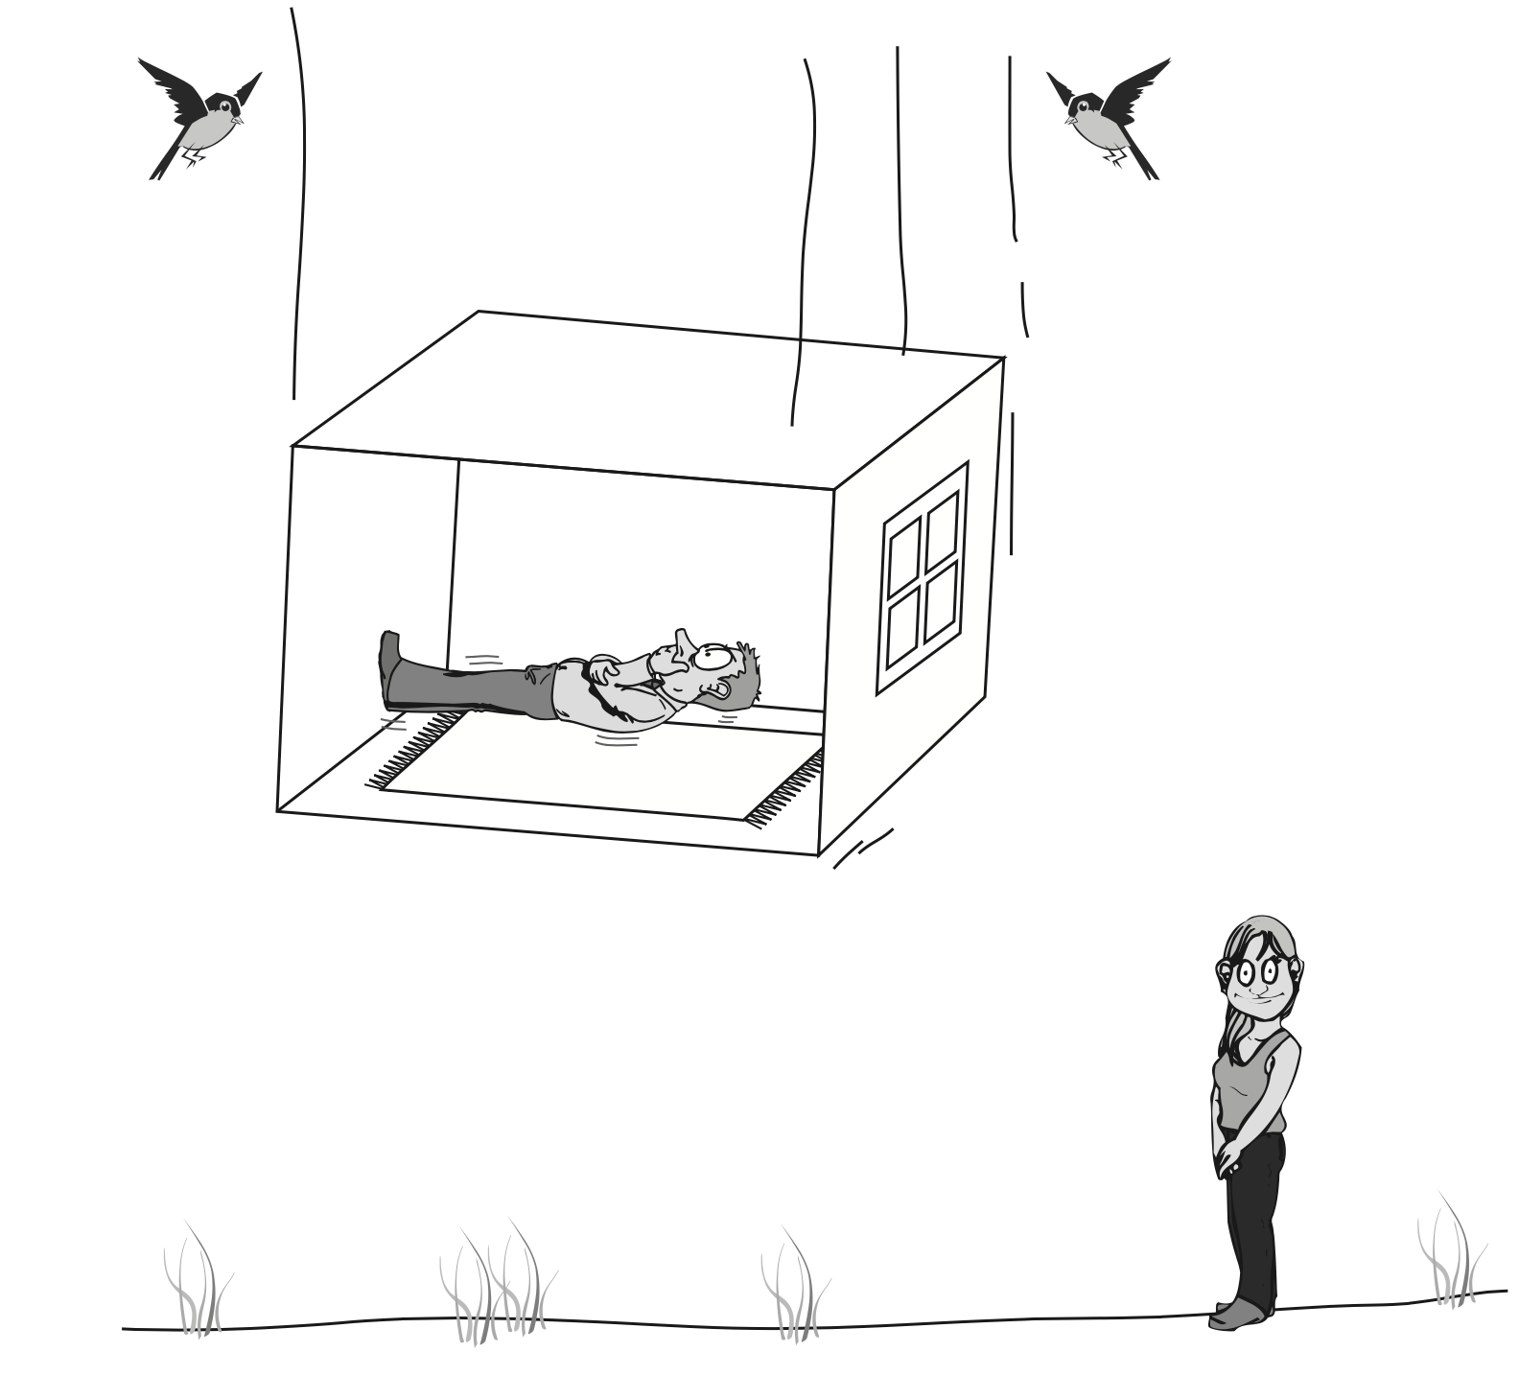

Slide 46
Max Planck and Albert Einstein

Slide 56
The most beautiful thing we can experience
is the Mysterious.
Dark (i.e., invisible) matter is 84% of all matter.
Dark energy is 68% of the energy of the universe.
What are they?
Why the Higgs? Why does it couple so weirdly?
Why are the electroweak interactions so lopsided?

Slide 57
Roy J. Glauber, Phys. Rev.84, 395 (1951).
2. T.R. Govindarajan and Sumanta Chakraborty,
Mod. Phys. Lett. A 34, 2050013 (2019).
3. John Nash, The Imbedding Problem for Riemannian Manifolds,
Ann. Math. 63(1), 20–63 (1956).
4. O. Müller and M. Sánchez, Lorentzian manifolds isometrically
embeddable in , Trans. Amer. Math. Soc. 363(10), 5367–5379 (2011).
5. Luis Aké, José L. Flores and Miguel Sánchez, Structure of globally
hyperbolic spacetimes with timelike boundary, Portugaliae Mathematica
80 (3/4) 291-313 (2023), arXiv:1808.04412.
6. K.C., PRD 102, 065011 (2020); 106, 029901 (2022); hal-04168724.

